Slide 1
Sea Beach view from Hotel
PRESENTED BY
NAME | ID
MIRZA MD TAWHID | 20-42643-1
MD MEHRUB KHAN LIMON | 20-42411-1
GOUROV SAHA | 20-42977-1

Slide 2
PROPOSAL
A view or scene of a sea beach will be represented by graphical drawing algorithms. This is a mini project in computer graphics which is simple, good looking . We have mainly created some artifacts in this mini project like sky, sea, a sun, moon. There will be trees, hotel beside the beach and moving ship on the sea. Some birds will be seen flying in the sky in the day mode of the view. In the night view , there will be calm nature with moon and stars. This is an overview of our project. This project is made with C++ language including glut with OpenGL

Slide 3
LIST OF OBJECT
stars
moon
sun
road
beach
bench
cloud
Umbrella
cargo ship
flagship
tree
containerTrack
Lighthouse
mountain
watchTower

Slide 4
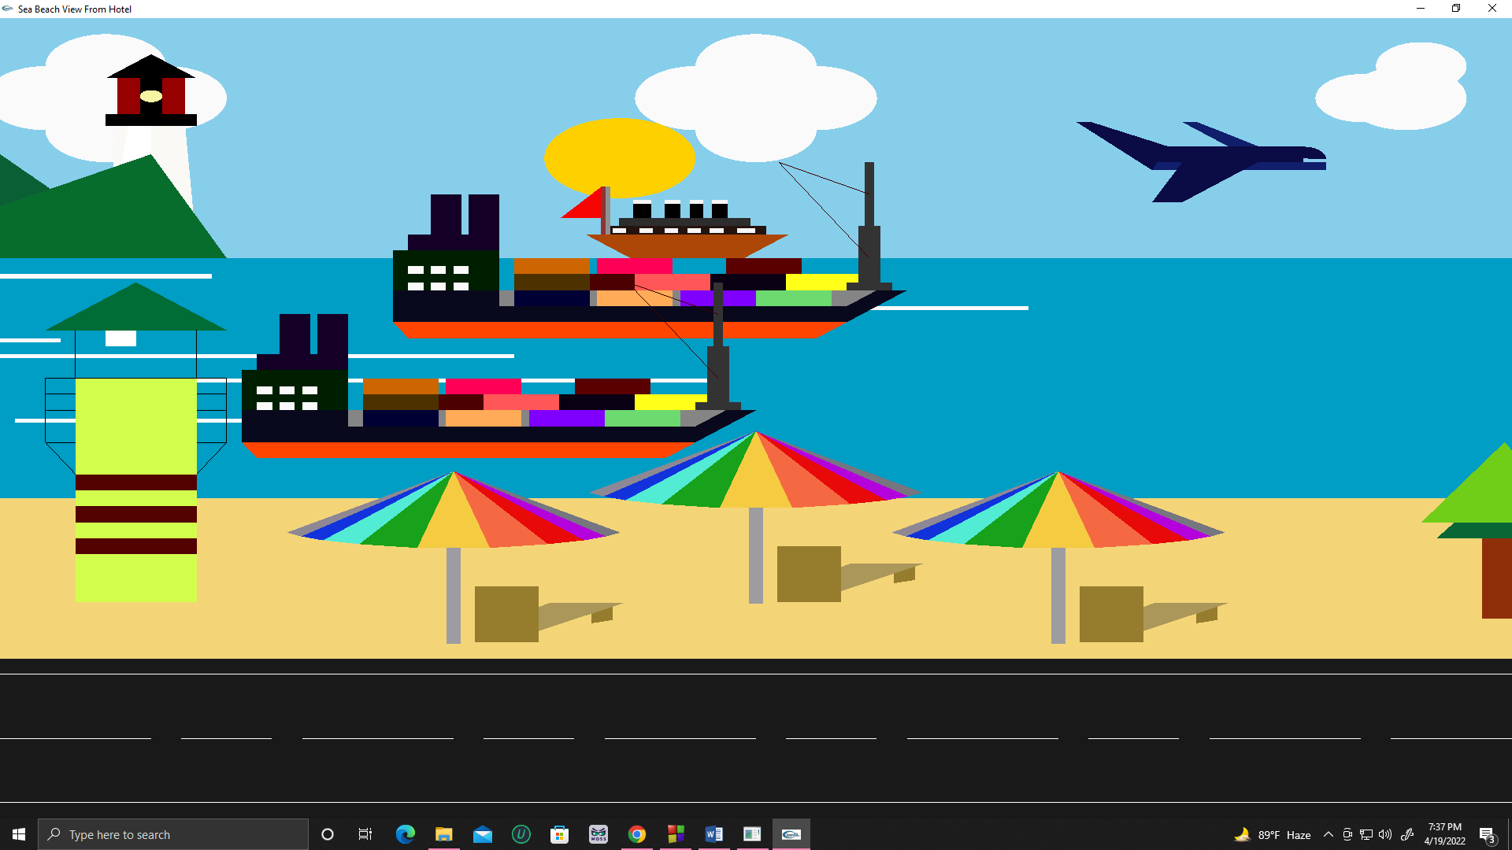
BEACH VIEW: DAY

Slide 5
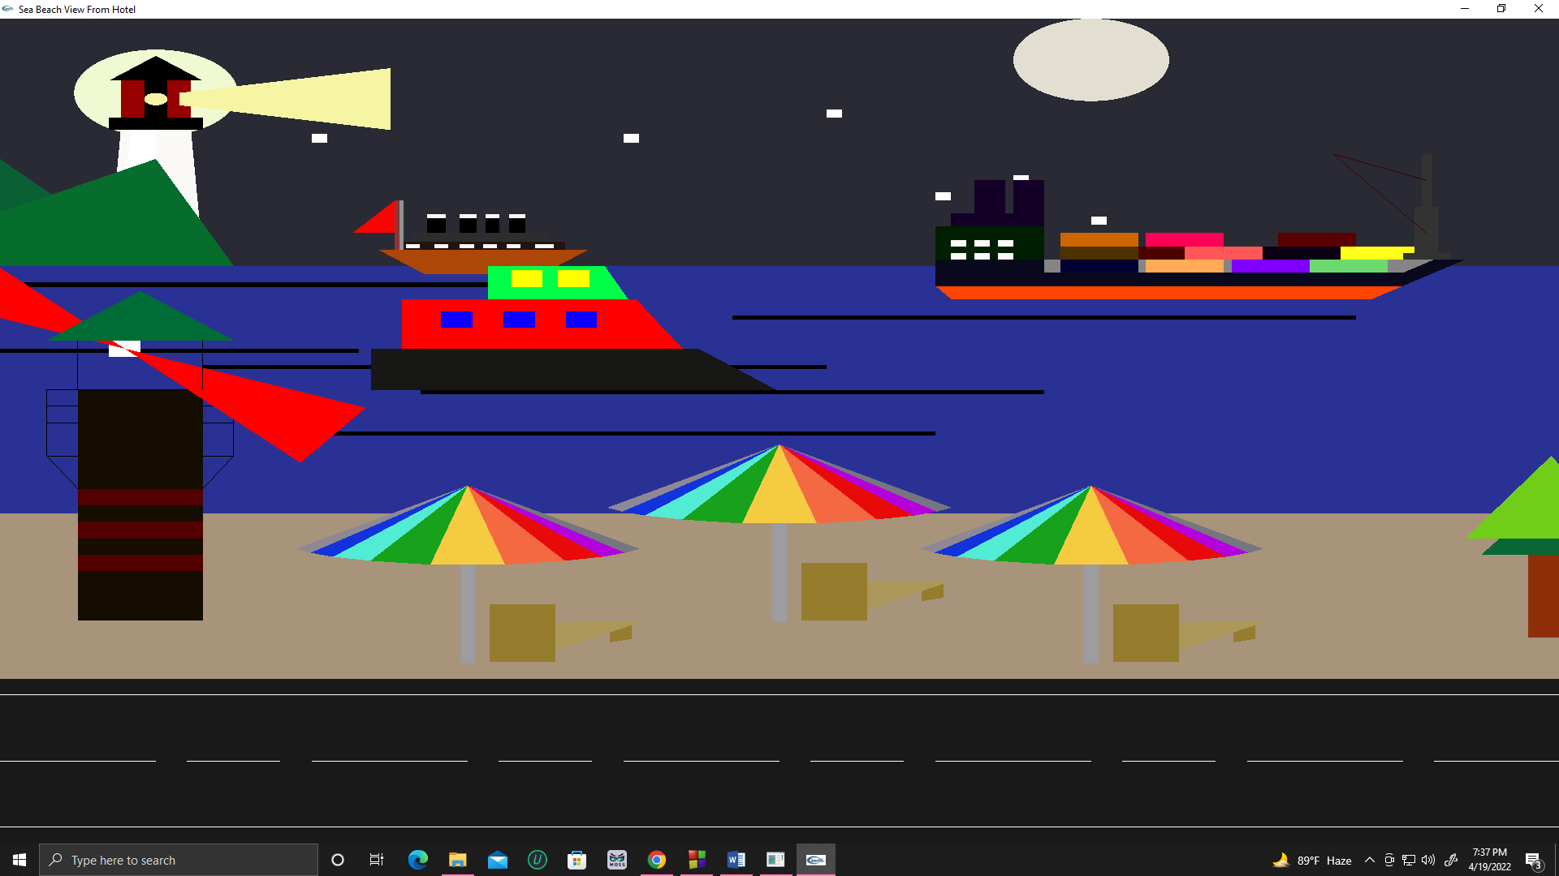
BEACH VIEW: NIGHT

Slide 6
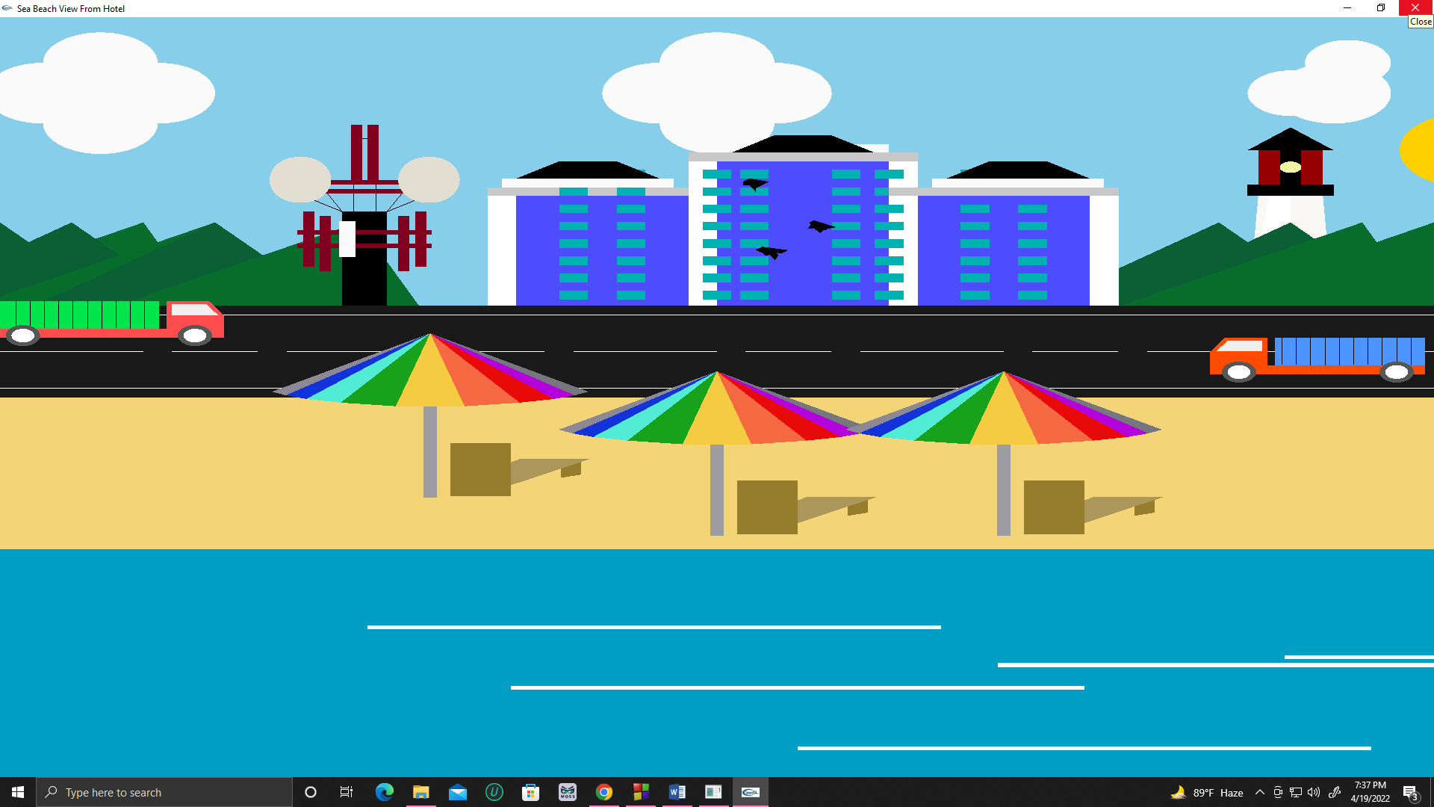
HOTEL VIEW: DAY

Slide 7
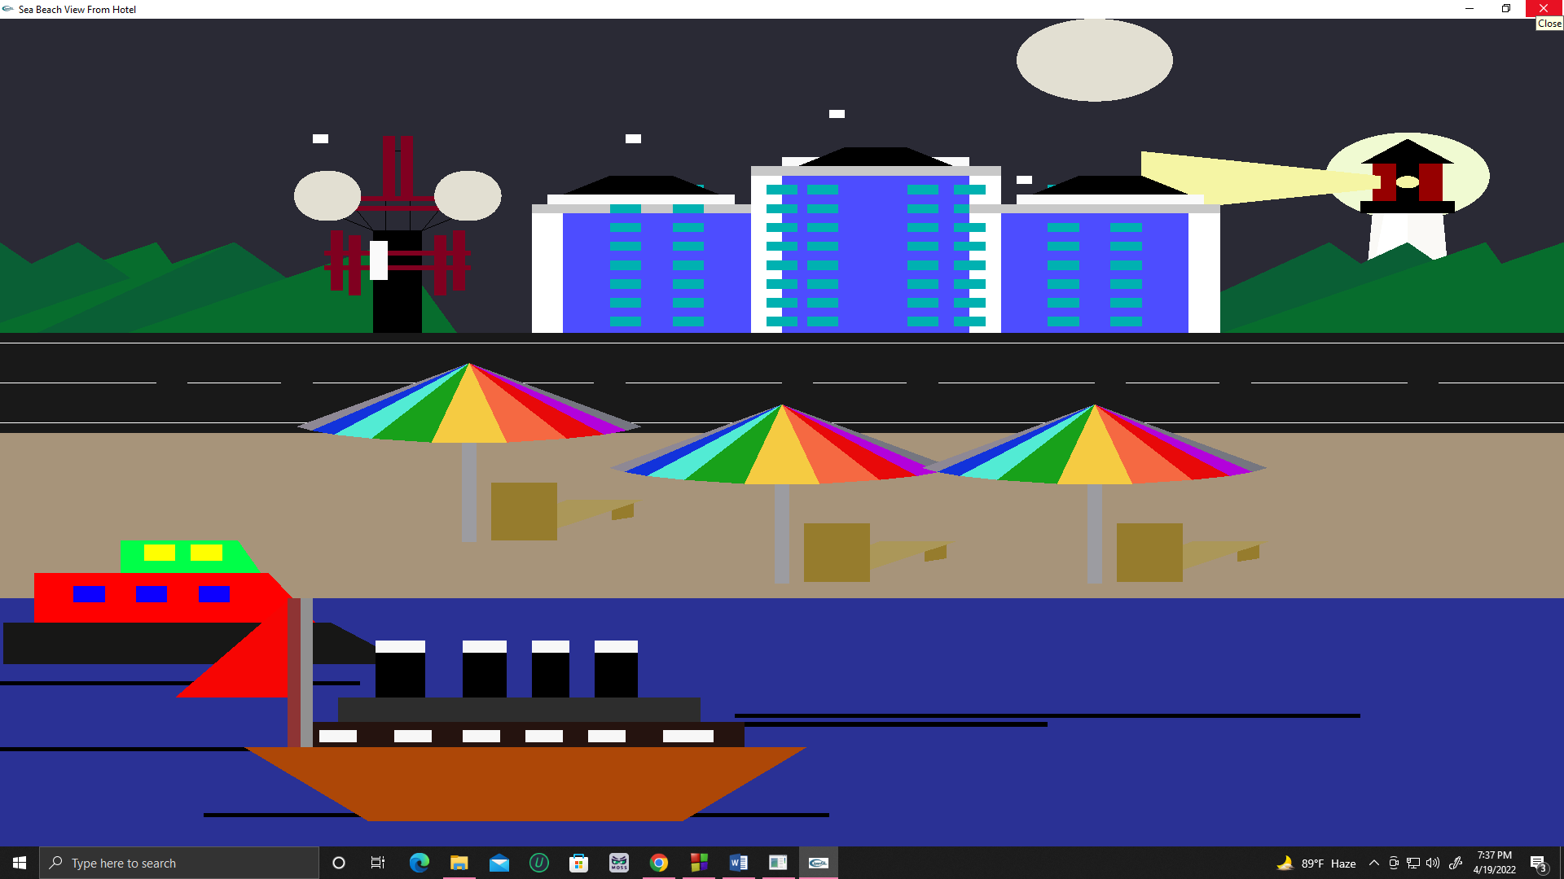
HOTEL VIEW: NIGHT

Slide 8
Thank You

